Slide 1






Insights and Analysis on a Secure Future
Team Vision
Notes:
Final Presentation Instructions:
Plan to use 8-10 PowerPoint Slides
See sample final presentations on the course site (Resources / Assignments / Final Project / Sample Final Presentations) to get an idea of what past student teams have done; you need to decide what specific slides you want to use and how you want to design them
Be sure to focus on your recommendations and supporting analysis
Have a role for each team member
Dress is business casual, as if you are presenting to your client
There will be a panel of business-people in the room as well, and they will ask you questions and provide feedback.
The main idea is to convey the nature of your work, the insights you have gained, and the specific recommendations that you have for your client. You should be sure to justify your recommendations.

Slide 2
Agenda
Our Team
About Blackberry
Industry Analysis
Firm Analysis
Recommendations

Slide 3

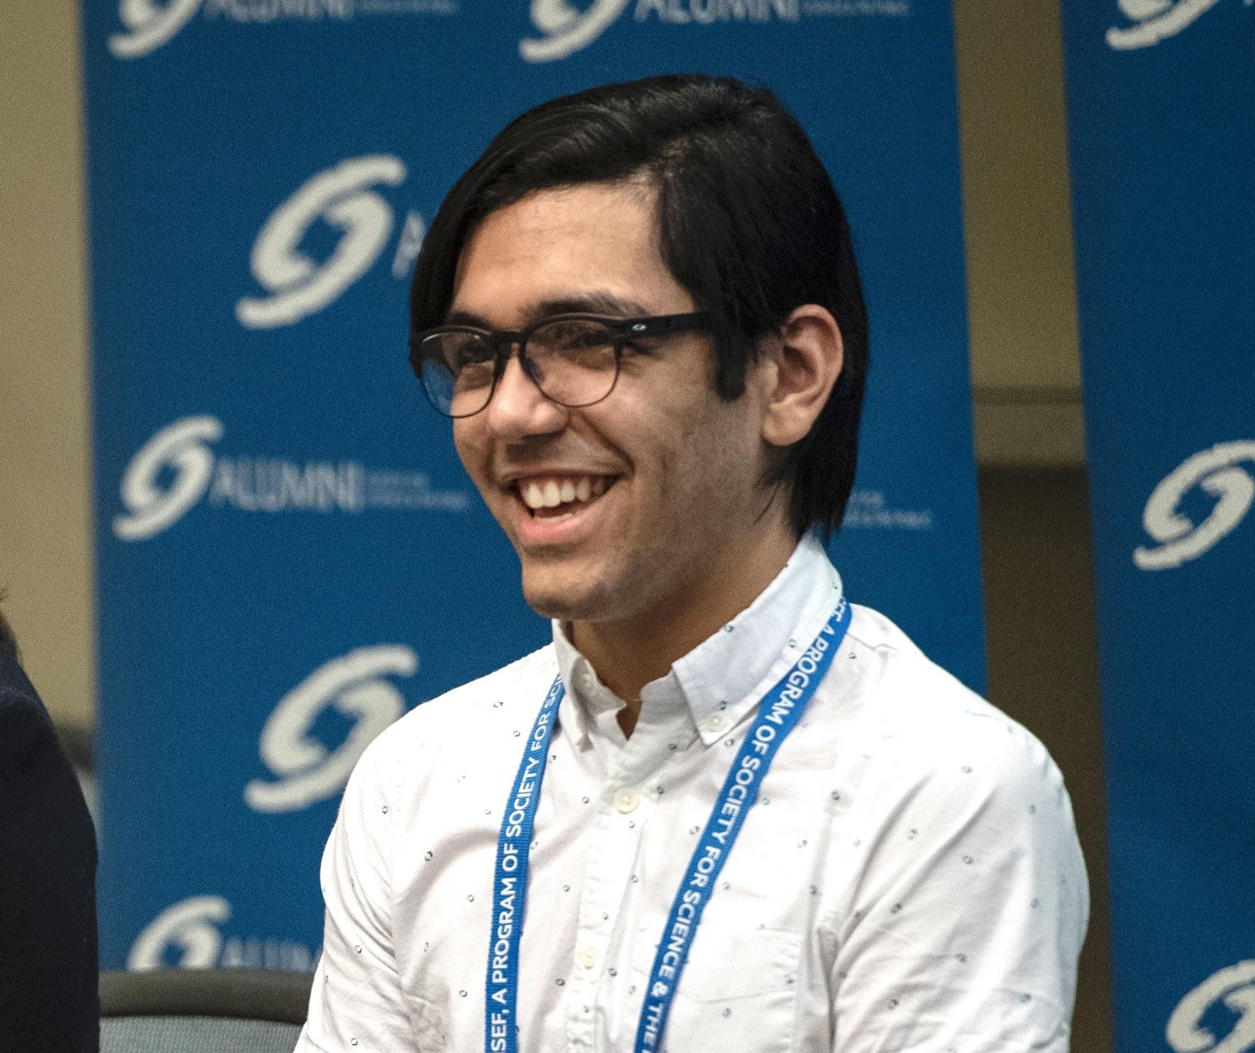
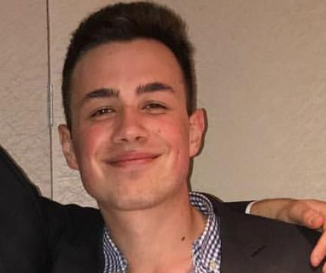
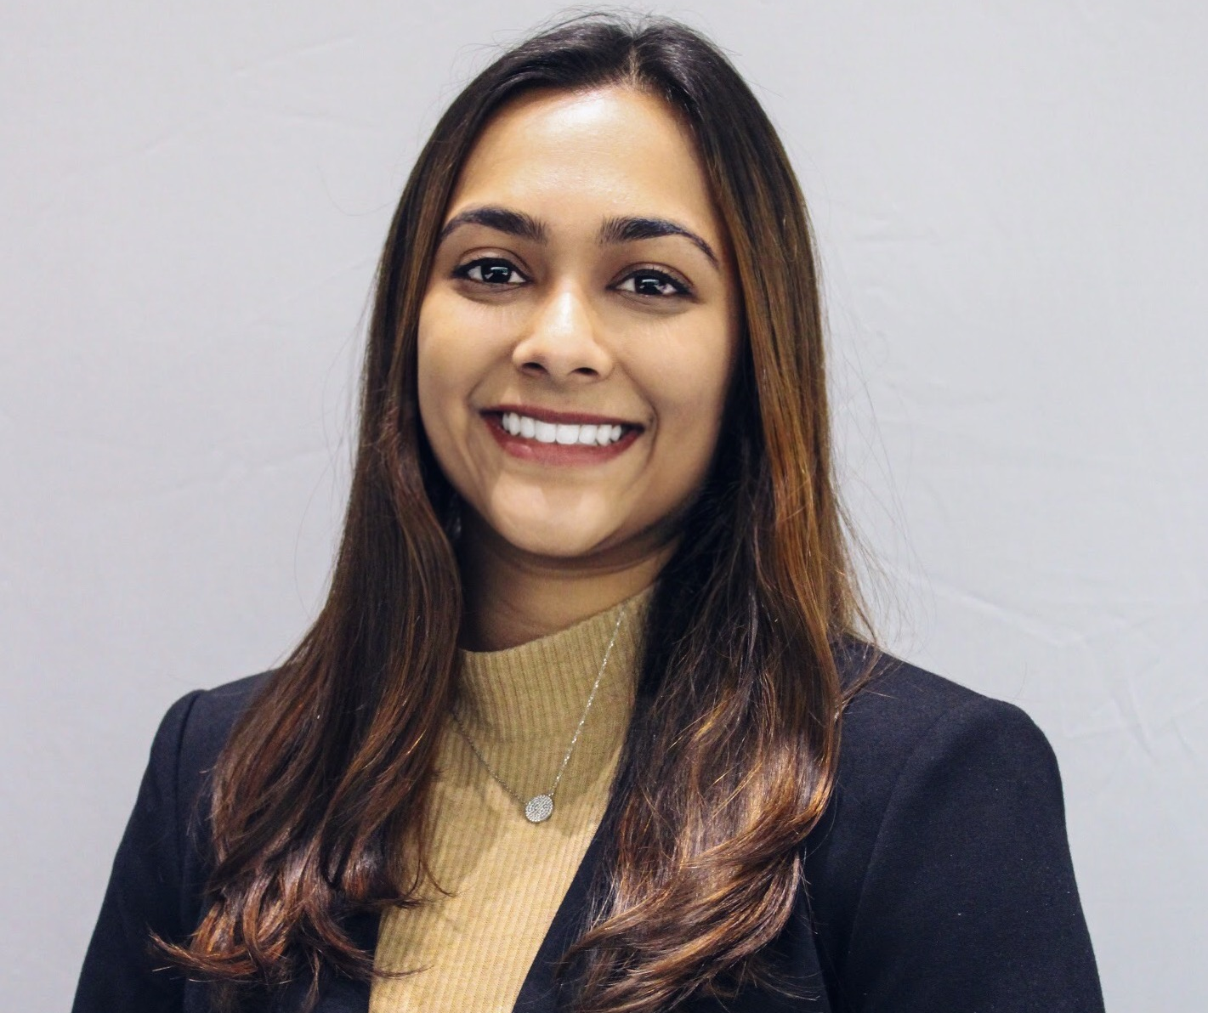
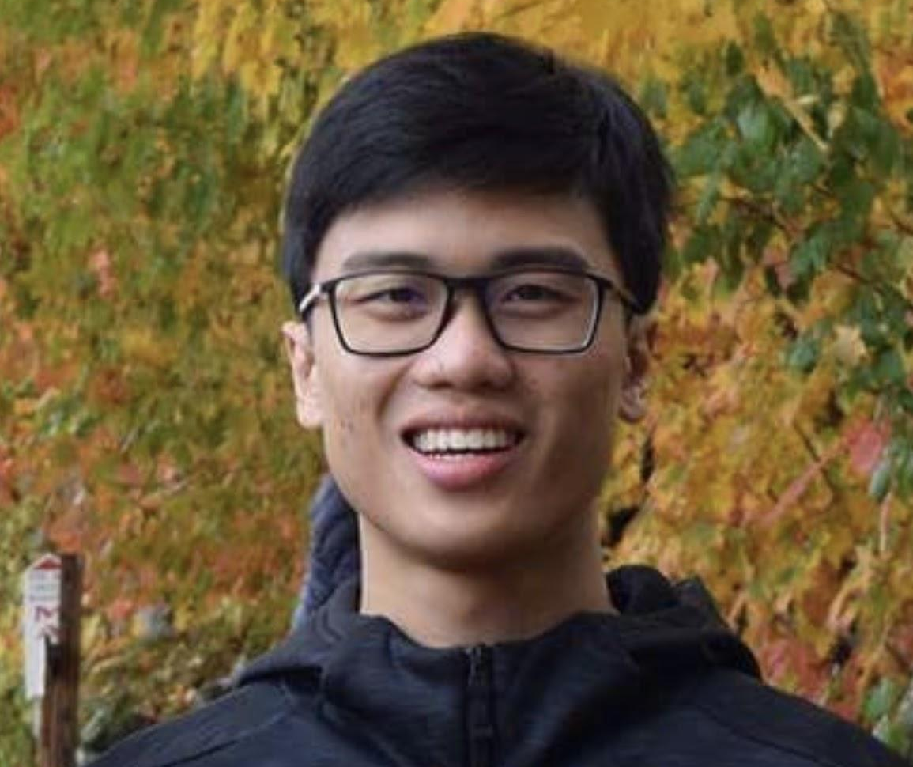
Strategist Team
Kirsten Kerr
Strategy
Norman A. Toro Vega
Computer Engineering
Nicholas Gjerasi
Finance
Shivani Merchia
Biomedical Engineering
Aaron Pan
Biomedical Engineering

Slide 4
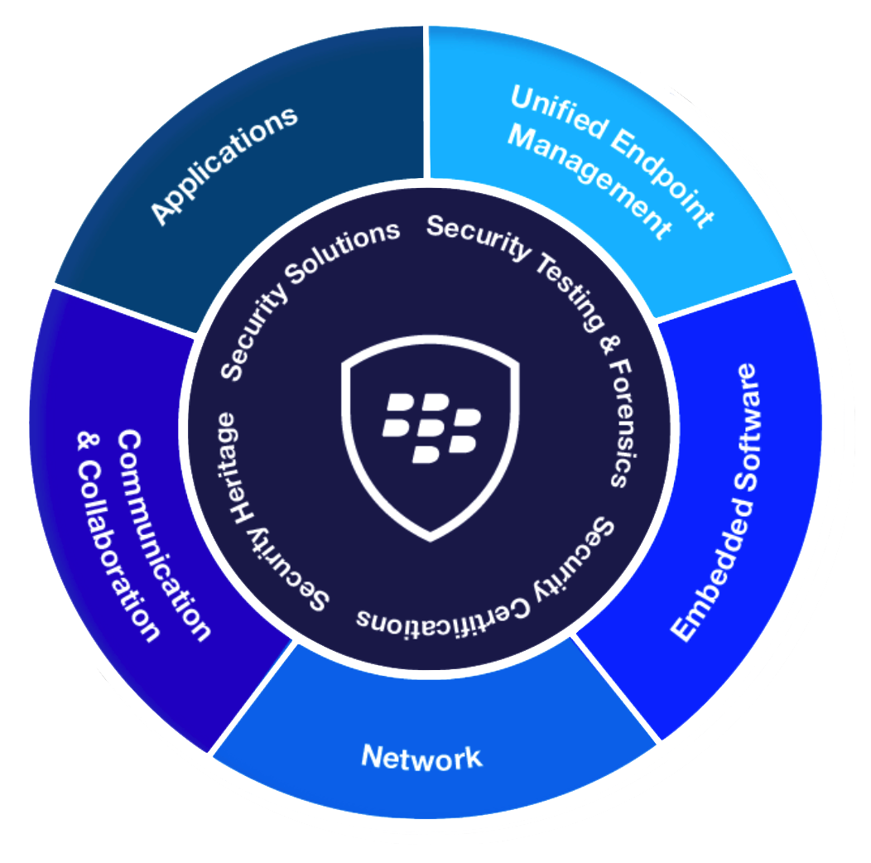
About Blackberry
BlackBerry provides organizations with software to secure the IoT devices they use, the products they make, the data they share and their communications.
Operations:
Founded in 1984
Operates in 30 countries
Customers:
7 of the 7 largest automotive Tier Ones
All 5 of the largest media companies
9 of the top 10 global financial services brands
Security Innovations:
Software as a Service (SaaS)
Centralized Communication Service
Secure Mobile Applications
AI-Driven Endpoint Protection
Notes:
The Internet of Things represents the next great wave in business transformation. Today, BlackBerry already secures more than 500M endpoints including 150M cars on the road. BlackBerry is leading the way with a single platform for securing, managing and optimizing how intelligent endpoints are deployed in the enterprise, enabling our customers to stay ahead of the technology curve that will reshape every industry.
Software as a service through their desktop environment; used in the browser
Encrypted messaging system

Slide 5
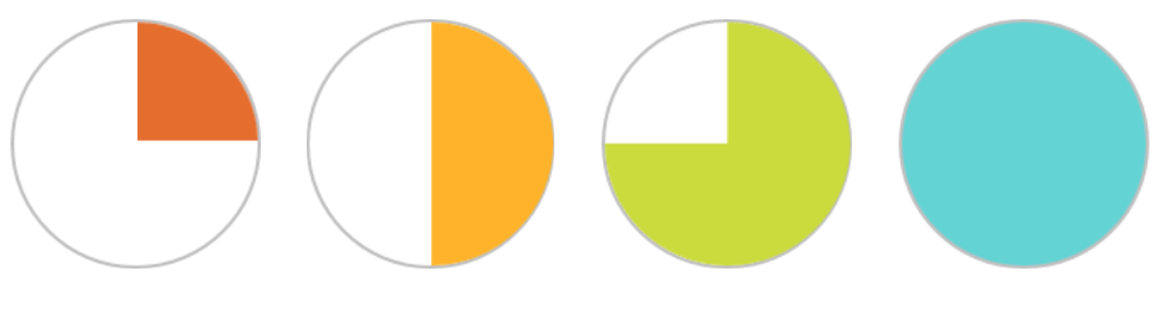
Industry Analysis
The capital requirements to enter this industry are extremely high which drastically lowers the risk of a new competitor dominating the space
Threat of New Entrants
This industry is saturated with firms bringing similar products to the market; this competition hurts industry profitability
Supplier Power
Industry Rivalry
Buyer Power
Threat of Substitutes
This industry has a very limited supply chain which reduces their importance and power over Blackberry
The vast amount of businesses with security needs paired with high switching costs creates a landscape where Blackberry has power over buyers
There are hardly any true substitutes to corporate data security asides from switching to a paper only operation
Notes:
Buyer Power
The vast amount of businesses with security needs paired with high switching costs creates a landscape where Blackberry has power over buyers
Rivalry
This industry is highly competitive and this competition has an adverse effect on Blackberry’s revenue
Substitutes
There are hardly any true substitutes to corporate data security asides from switching to a paper only operation
Supplier Power
This industry has a very limited supply chain which reduces their importance and power over Blackberry
Threat of New Entrants
The capital requirements to enter this industry are extremely high which drastically lowers the risk of a new competitor dominating the space

Slide 6
Strategic Firm Analysis
Strengths All-inclusive security consulting and implementation AI driven human error identification and solutions Physical asset transportation tracking and security | Weaknesses Firm stuck in red ocean strategy Product not differentiated enough to stand out in highly competitive industry Competitors like Microsoft have exponentially more assets and ability to develop new products
Opportunities Leverage their unique AI human error of their security platform Expertise in smartphone security allows for major partnerships with smartphone producers | Threats Significant amount of competitors with more funding Aggressive acquisitions which can lead to insolvency if they can't find the synergy

Slide 7
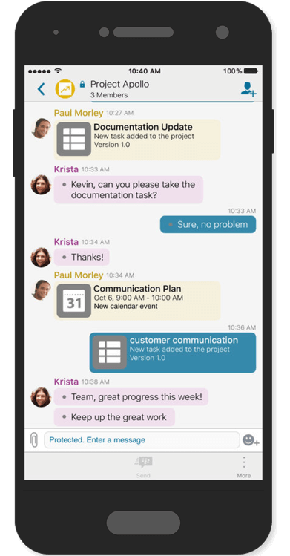
Recommendation #1
Implement a Social Strategy
Increase WTP by helping people strengthen relationships
Freemium model for customers to invite their clients under the BBM secure communications platform for X amount of time

Slide 8
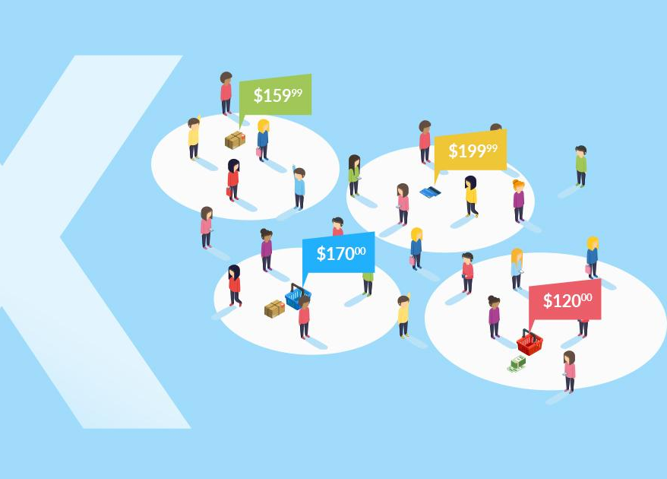
Recommendation #2-
Versioned Cost Structure
Accommodate different levels of corporations
Adjusted by number of employees, countries they operate in, number of devices, or level of protection

Slide 9

Recommendation #3
Buy Out
Leverage AI security platforms
Huge demand for AI security
Reduce R&D cost for buyer
Leverage supply chain management
Produced high volume of phones
Global market
Potential buyer: Facebook

Slide 10

Recommendation #4
Collaborate with Android Device Manufacturers
Larger consumer base
Largest market share
Only open source OS that rivals Apple
Data privacy is important for android
Security breaches would harm customer’s trust
Reduce R&D costs for android
Receive brand recognition

Slide 11
Thank you

